Slide 1
LECTURE: 1
Search Strategies

Slide 2
Introduction to Search Strategies:
  Explore problem spaces effectively
  Aim to find solutions and goals
  Select the best path or actions
  Guide navigation through possible states
  Crucial for problem-solving, optimization, decision-making

Slide 3
Importance of Search Strategies:
  Solving problems: Sudoku, Google Maps
  Search programming: Code debugging, Search engines
  Goal-based agents: Siri, Autonomous vehicles
  Support production systems: Workflow Automation
  Neural network systems: Face ID, Alexa

Slide 4
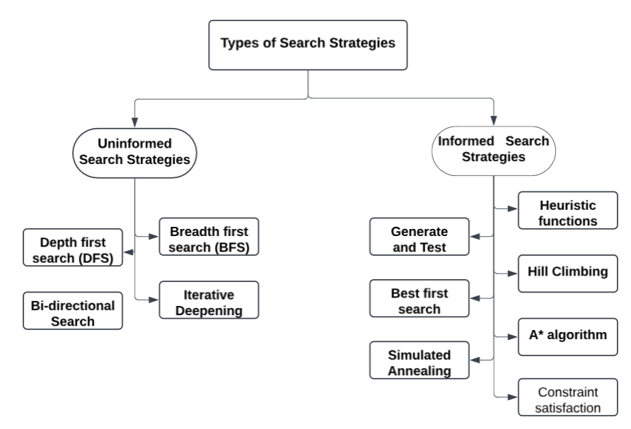
Types of Search Strategies:

Slide 5
Evaluating Search Strategies:
Completeness
Time complexity
Space complexity
Optimality

Slide 6

Uninformed Search Strategies:
  No additional problem-specific knowledge used
  Explore search space blindly
  Focuses on structure, not heuristics
  Guarantees a solution if it exists
  Less efficient for large problems

Slide 7
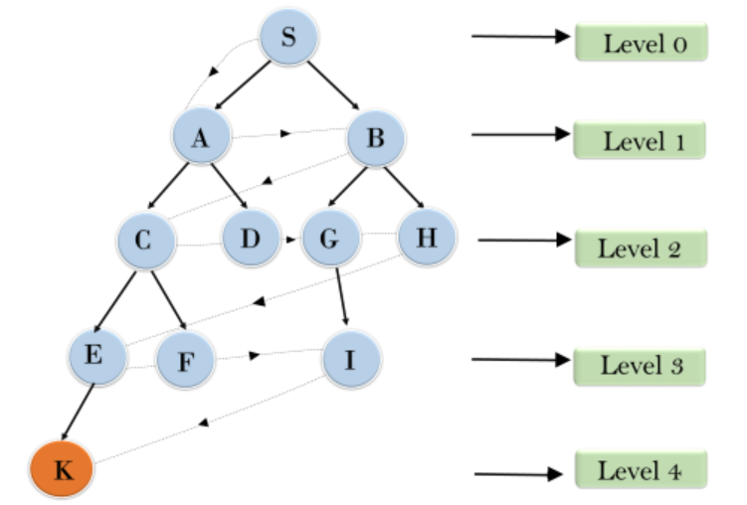
Breadth-First Search (BFS)
Explores level by level.
Expands nodes by increasing depth
Find shortest path in unweighted graph
Implemented using FIFO queue data structure.
Time complexity: O(V+E)
Space complexity: O(V)

Slide 8
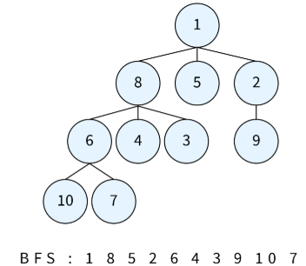
Algorithm of Breadth-First Search (BFS)
Create an empty queue, enqueue root.
While queue isn’t empty, continue process.
Dequeue the front node from queue.
Check if dequeued node is goal.
If not, enqueue unvisited neighbors.
Repeat until goal found or queue empty.

Slide 9
Advantages of BFS:
Finds the shortest path fast
Explores all possibilities
Simple and easy to implement
Guarantees complete solution
Good for shallow searches
Suitable for unweighted graphs

Slide 10
Disadvantages of BFS:
High memory consumption
Slow for large graphs
Inefficient for weighted graphs
Requires additional storage space
Fails with infinite paths
Expensive computationally at scale

Slide 11
NEXT: Diving Deep with DFS & Bi-Directional Search

